Slide 1

Instant Coffee
Consumer Analysis
Notes:
Our group worked on the instant coffee dataset to answer a research question of what differences exist between heavy VS light consumers

Slide 2
Data: Transaction level
Aggregation by
- week
- household
- brand
1. Price elasticities
2. Buying behaviours
- loyalty
- promotion
Notes:
We had data on 270k transactions over a period of one year
We simplified the data by taking out brands and stores that didn’t appear frequently in the dataset
We then aggregated the data by some areas to firstly compute price elasticities -> which could tell us something about the market
and secondly -> about differences in behaviour

Slide 3
Consumer segments
Heavy consumer
Light consumer
Notes:
So we characterized HEAVY consumers as the 75th % and LIGHT as the 25th % and focused our analysis on these

Slide 4
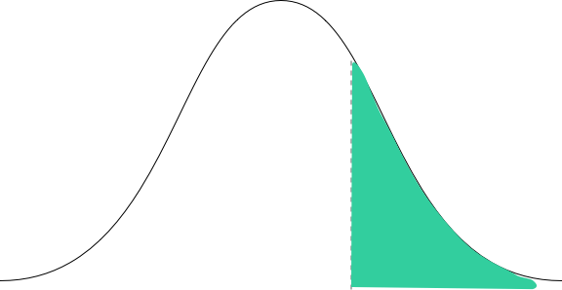
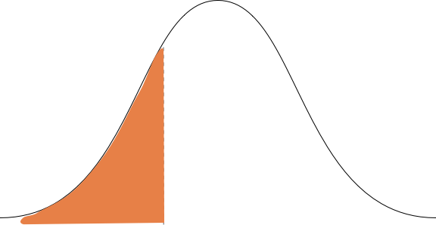
Consumer segments
Heavy consumer
Light consumer
Notes:
So we characterized HEAVY consumers as the 75th % and LIGHT as the 25th % and focused our analysis on these

Slide 5


Users have different price sensitivities

Slide 6
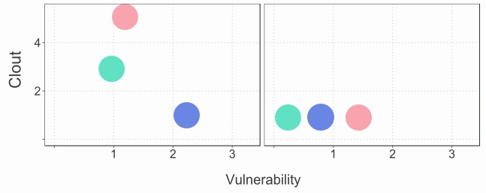

Clout and Vulnerability
Heavy consumer
Light consumer

Slide 7
They also exhibit different buying behaviours

Slide 8
Buying behaviours
Importance
Promotion response (Price)
Maximum spend per visit
Average packs per visit
Average spend per visit
Average weekly visits
Minimum spend
Brand loyalty

Slide 9
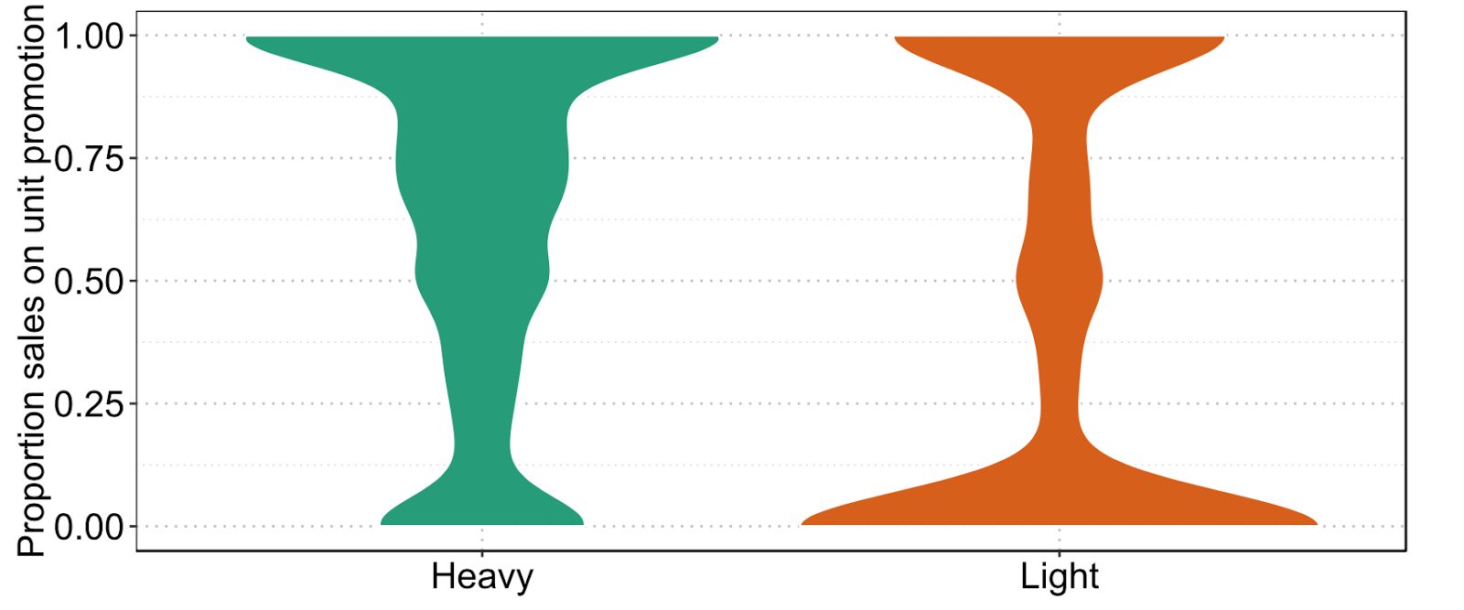
Promotion response
100
75
Sales on price promotion [%]
50
25
0

Slide 10
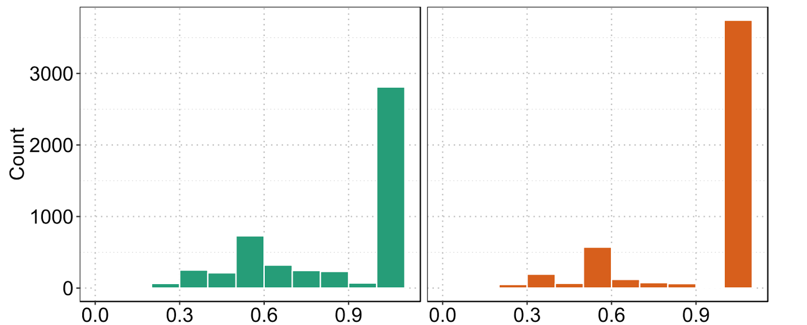
Loyal Customers
Number of households
Brand loyalty [Herfindahl]
Heavy consumer
Light consumer

Slide 11
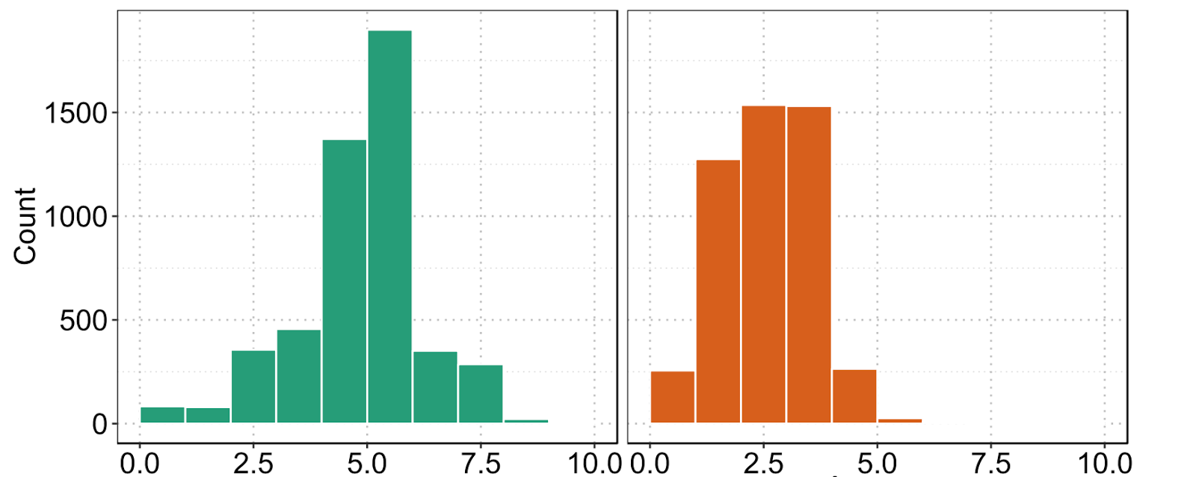
Big spenders
1,500
Number of households
1,000
500
0
0.0
2.5
5.0
7.5
10.0
0.0
2.5
5.0
7.5
10.0
Maximum spend in any single trip [GBP]
Heavy consumer
Light consumer

Slide 12
Summary
Notes:
We believe our findings tell a clear story on what the major differences are of the two consumer segments
Let’s do a quick recap

Slide 13
Summary
Heavy consumer
Light consumer
~ 100% more price sensitive
Responsive to promotions
~ 50% less total spend
More brand loyal

Slide 14
Recommendations
Heavy
Light
Value
Product standardisation
Branding campaigns
- Differentiation
- CSR
Size
Promotion
Distribution
Limited time coupons with each product purchased
Increase product variety
Notes:
The behaviour of the two segments are nearly opposite

Slide 15
Recommendations
Heavy
Light
Value
Introduce larger pack sizes
Product standardisation
Branding campaigns
- Differentiation
- CSR
Size
Promotion
Distribution
Limited time coupons with each product purchased
Increase product variety

Slide 16
Recommendations
Heavy
Light
Value
Introduce larger pack sizes
Product standardisation
Branding campaigns
- Differentiation
- CSR
Size
Promotion
Distribution
Limited time coupons with each product purchased
Increase product variety

Slide 17
Questions
Notes:
Our group worked on the instant coffee dataset to answer a research question of what differences exist between heavy VS light consumers

Slide 18
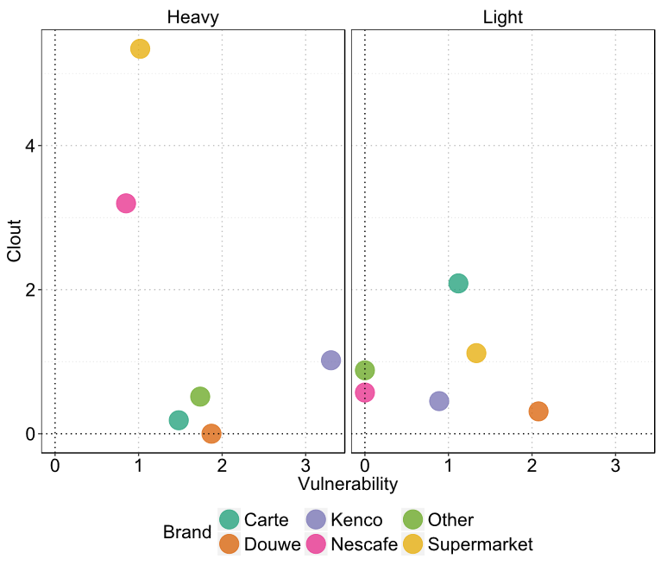
Clout and Vulnerability

